Slide 1
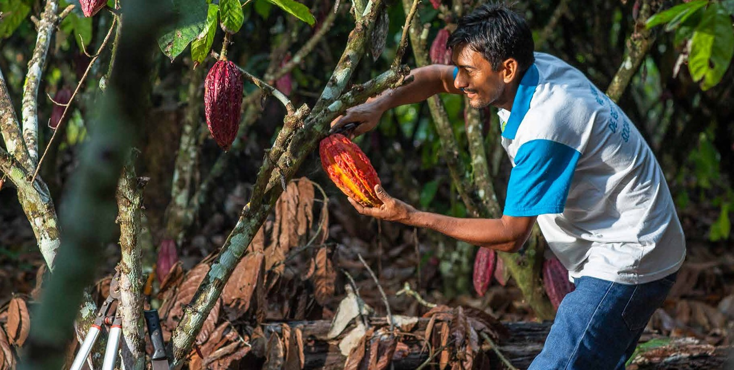
Landscape Finance: Investing in innovation for sustainable landscapes
GLF Investment Case 2019
Youth in Landscapes Finance Workshop: Pre-course learning

Slide 2
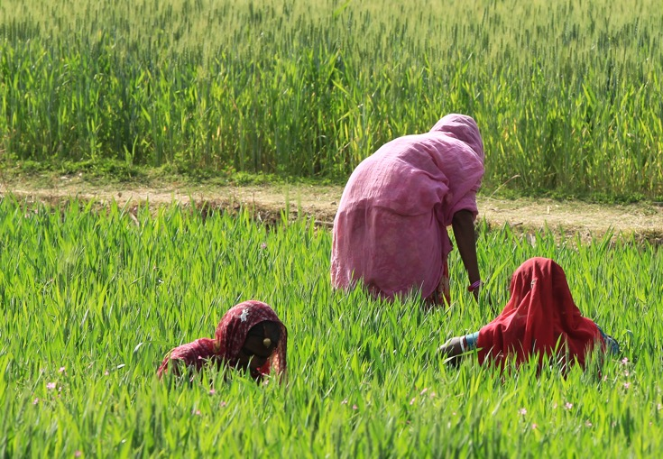
Introduction
Navigate: Intro / Your landscape / Landscape approaches / Landscape Investments / Business Case / Sources of Capital / Blended Finance / Bankable propositions / Your assignment
Welcome!
This short module is for participants of the upcoming
one-day training on landscape finance, to be held alongside the GLF Investment Case in Luxembourg, November 29th, 2019
The objectives of this module are to get you started with some key concepts ahead of the face-to-face session, and to enable you to begin a structured exploration of your landscape case. The module should last max two hours.
The module contains some short videos on YouTube. You will need internet and audio.
The module content comes from the GLF Landscape Academy online course, “Landscape finance: Investing in innovation for sustainable landscapes”. You are encouraged to continue your learning by registering here for the full course.

Slide 3
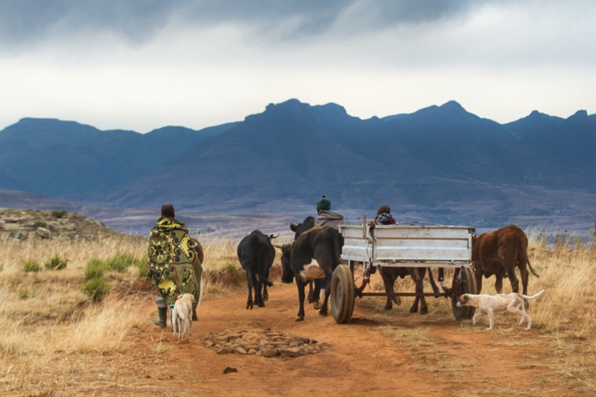
Introduction
Navigate: Intro / Your landscape / Landscape approaches / Landscape Investments / Business Case / Sources of Capital / Blended Finance / Bankable propositions / Your assignment
Content overview:
Your landscape case
Recap on landscape approaches
Investments in the landscape
The business case for for-profit landscape investments
Sources of capital for landscape investments
Blended finance for landscape investments
Improving ‘bankability’ of landscape investments
Finalising your landscape case

Slide 4
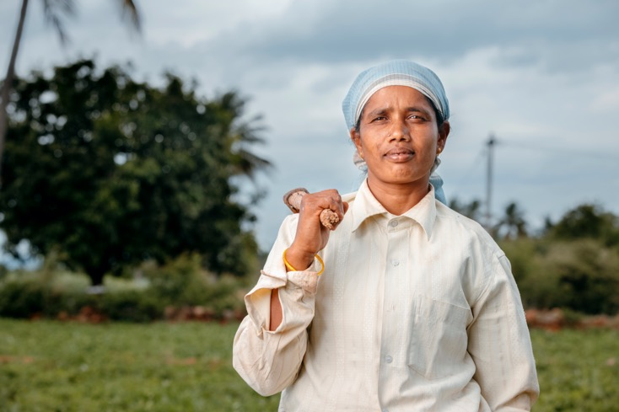
Your landscape case
Navigate: Intro / Your landscape / Landscape approaches / Landscape Investments / Business Case / Sources of Capital / Blended Finance / Bankable propositions / Your assignment
Bring your landscape with you!
True learning happens when you can apply the content you hear in a course or workshop, to your own case and situation.
Case-based learning increases the dynamism of the learning experience and helps to show you your own potential to make real change.
While you are learning about some basic landscape finance concepts, you will be prompted to apply what you hear to your own landscape case.
You’ll end the module with a description of your case that you can take along to the day in Luxembourg.
Note: You don’t need to make elaborate paragraphs or designs; just a few words to help guide your thoughts and prepare you to fully benefit from your day in Luxembourg. So short and sharp!

Slide 5

Video 1
Navigate: Intro / Your landscape / Landscape approaches / Landscape Investments / Business Case / Sources of Capital / Blended Finance / Bankable propositions / Your assignment
Recap on landscape approaches
Start with the landscape
I’m sure that your motivation to attend the GLF event means you’re already interested in and familiar with, landscape thinking and approaches.
But, watch the video to ensure that your understanding matches that of your fellow learners in the upcoming event. The first step in collaborative learning and planning, is developing a shared understanding!
Your landscape case:
After watching the video, think about your landscape/case and write down:
What is a key issue that is affecting the landscape? Describe this in a few short sentences
Who are the 5-7 major stakeholders around this issue?
How are their businesses affected by the issue?
How do their businesses affect or contribute to the issue?
Video not working? Visit YouTube to watch it

Slide 6
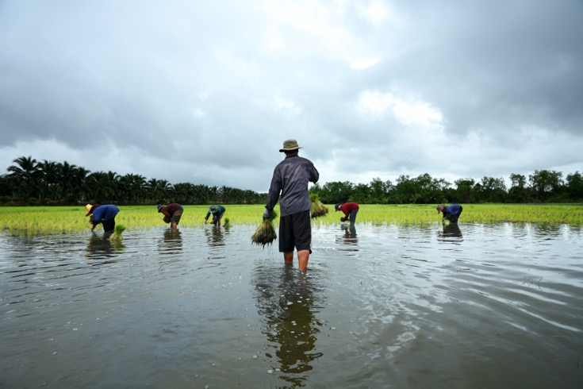
Investments in landscapes
Navigate: Intro / Your landscape / Landscape approaches / Landscape Investments / Business Case / Sources of Capital / Blended Finance / Bankable propositions / Your assignment
The right investment for the right investor
There are many different ways to look at the large topic of landscape finance. In this module, you will focus on the investments that different people and organisations make in order to achieve their social, financial or environmental objectives.
And with such a diverse array of public and private, local and global, profit and non-profit seeking actors out there, there are of course many different types of investments.
In the coming two videos, we will explore two fundamental investment categorisations. Doing so will quickly sharpen your understanding of the complex need for investments in landscapes.

Slide 7
Video 2
Investments in landscapes
Navigate: Intro / Your landscape / Landscape approaches / Landscape Investments / Business Case / Sources of Capital / Blended Finance / Bankable propositions / Your assignment
Integrating investments in the landscape
In general, there are two main types of investments to consider; sustainable land use investments and integrated landscape investments.
The distinction between the two is important to learn about, and in the next video, you will learn about the qualities and potential benefits of one over the other.
Your landscape case:
After watching the video, think about your landscape/case:
To ensure that you understand the difference between the two types of investments, pick a small number of your stakeholders and write down what types of investments they make? Are any of these integrated landscape investments?
Video not working? Visit YouTube to watch it

Slide 8
Investments in landscapes
Navigate: Intro / Your landscape / Landscape approaches / Landscape Investments / Business Case / Sources of Capital / Blended Finance / Bankable propositions / Your assignment
Video 3
Multiple purposes of landscape investments
In this video, you will learn about ‘asset’ and ‘enabling’ investment categories.
This fundamental difference is essential to understand, as herein lies the key reason for public and private engagement toward landscape transformation.
Your landscape case:
After watching the video, think about your landscape/case and write down:
Highlight some examples of asset and enabling investments
Are there patterns about who is making enabling investments?
Video not working? Visit YouTube to watch it

Slide 9
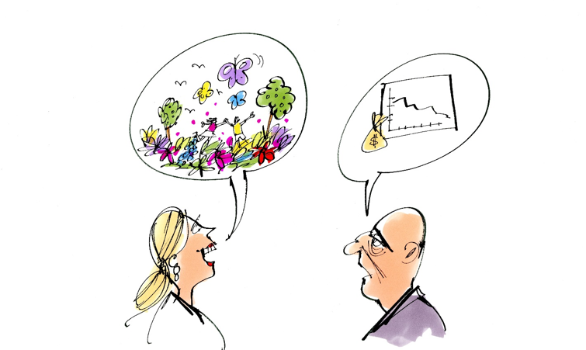
Attracting for-profit investment
Navigate: Intro / Your landscape / Landscape approaches / Landscape Investments / Business Case / Sources of Capital / Blended Finance / Bankable propositions / Your assignment
Highlighting potential returns
Take a moment to caption the cartoon for yourself. What do you see?
The cartoon highlights a familiar scene. Sustainable development professionals (taken here as a broad term which encompasses agri-food system development professionals and environmental protection/ conservation professionals) may have a good, innovative idea for a project or programme that delivers solid social or environmental returns. But her story does not seem to discuss the numbers....
Private sector, profit-seeking, engagement has been one of the main topics of discussion and debate in the sustainable development domain for a number of years now. Multiple models, ideas and mechanisms exist which try to mobilise the vast amounts of private capital that exist and guide it towards solving pressing landscape issues.
At their core, is the need to highlight the potential returns that investors can achieve.

Slide 10
Video 4
Navigate: Intro / Your landscape / Landscape approaches / Landscape Investments / Business Case / Sources of Capital / Blended Finance / Bankable propositions / Your assignment
Attracting for-profit investment
The business case for investing in landscapes
I’m sure you’ve heard of the business case before; it’s common language nowadays when trying to get funding for an activity or project.
But what does it actually mean? And how to make and present one? In the next video, you will hear why the business case is so important, not just to know, but to share.
Your landscape case:
After watching the video, think about your landscape/case:
Looking at the description you have been building up, and your expert knowledge of your case, are there any business cases emerging for new investors to enter the landscape? Or for existing investors to make new investments?
Video not working? Visit YouTube to watch it

Slide 11
Video 5
Navigate: Intro / Your landscape / Landscape approaches / Landscape Investments / Business Case / Sources of Capital / Blended Finance / Bankable propositions / Your assignment
Sources of capital
Sources of capital for landscape investments
Good news! Between the tens of billions of climate finance, impact investment funds and hundreds of billions in green bonds, there’s more than enough to address the needs of our planet’s landscapes!
Why then are the issues you know of in these landscapes still present? And why does but a tiny fraction of the potentially available capital actually enter into the land management domain?
There are a wide array public, private and civic sources of capital potentially available for landscape investments, originating and operating from the local to the global level. Watch the video to learn how they perform and assess landscape investments differently
Video not working? Visit YouTube to watch it

Slide 12
Navigate: Intro / Your landscape / Landscape approaches / Landscape Investments / Business Case / Sources of Capital / Blended Finance / Bankable propositions / Your assignment
Blending public and private capital
Video 6
Blended finance for landscape investments
So, you’ve explored the various mechanisms through which for-profit and not-for-profit investors get capital into landscapes. Increasingly, these investors are seeking to work together, to add value to each other’s investments.
In this next video, you will learn how and why public, private and civic actors seek to blend their investments.
Your landscape case:
After watching the video, think about your landscape/case and write down:
List any examples which you think may be blended finance in your landscape
Have you any useful ideas for blending finance to turn the landscape issue into a business opportunity?
Video not working? Visit YouTube to watch it

Slide 13
Navigate: Intro / Your landscape / Landscape approaches / Landscape Investments / Business Case / Sources of Capital / Blended Finance / Bankable propositions / Your assignment
Bankable propositions
Video 7
Improving the bankability of potential investments
You may have an investment idea which you love and think is fantastic. You may even be confident enough to take this idea to an investor.
But how will you sell the idea to the investor? How to make her/him as confident as you? And how to make them feel safe and secure enough?
In other words, how to make your proposition more bankable?
Let’s ask an expert. You’ll meet Gerhard Mulder in Luxembourg, but first, listen to his thoughts on how to calm a banker’s nerves.
Video not working? Visit YouTube to watch it

Slide 14
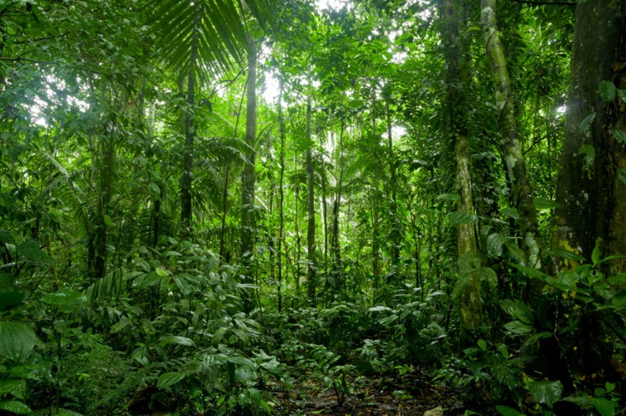
Your landscape case
Navigate: Intro / Your landscape / Landscape approaches / Landscape Investments / Business Case / Sources of Capital / Blended Finance / Bankable propositions / Your assignment
Bring your landscape with you!
So far, you have been applying what you see and hear in the videos to your own landscape case. I hope it has been rewarding!
You may have been making notes on paper or on a computer as you go through the module. Your final challenge is to turn this into something you can share with your fellow course participants.
You are encouraged to make a sketch, a nice table, or even a short vlog! When ready, I hope you’ll share this on the WhatsApp group! Make sure to bring your description with you to the course!
I hope you have enjoyed this module and I’m sure you will enjoy your time in Luxembourg!
#Thinklandscape!

Slide 15






About the content of this module
Navigate: Intro / Your landscape / Landscape approaches / Landscape Investments / Business Case / Sources of Capital / Blended Finance / Bankable propositions / Your assignment
The content you have been going through in this module is adapted from the Landscape Finance online course, developed by partners of the GLF Landscape Academy.
The course is hosted on EdX, and with additional landscape-focused courses, forms the Sustainable and Inclusive Landscapes Professional Certificate Programme.
You are encouraged to sign up and continue your learning!
Visit the Landscape Academy to learn more:
https://academy.globallandscapesforum.org/

Slide 16

Navigate: Intro / Your landscape / Landscape approaches / Landscape Investments / Business Case / Sources of Capital / Blended Finance / Bankable propositions / Your assignment
End

