Slide 1

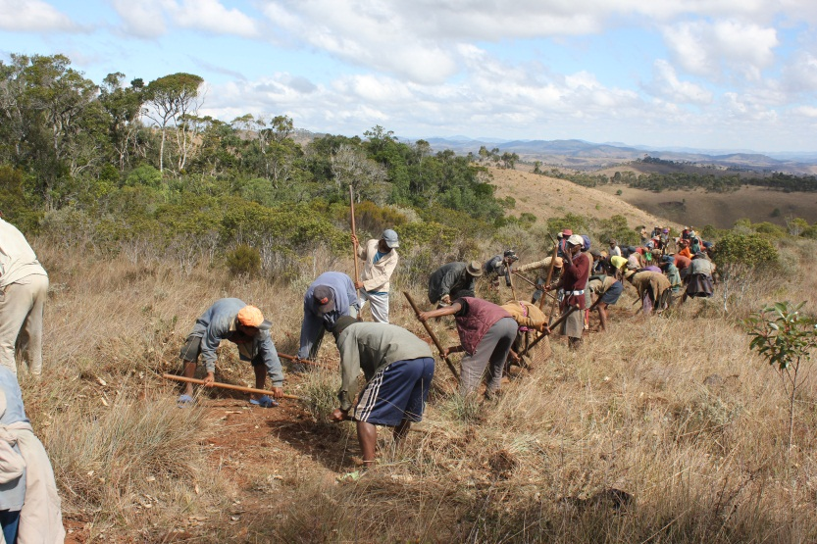
Lessons learnt from 13 years of FLR practice in Fandriana Marolambo, Madagascar
Simon Rafanomezantsoa
Appolinaire Razafimahatratra
WWF Madagascar
GLF – Nairobi
29 August 2018

Slide 2
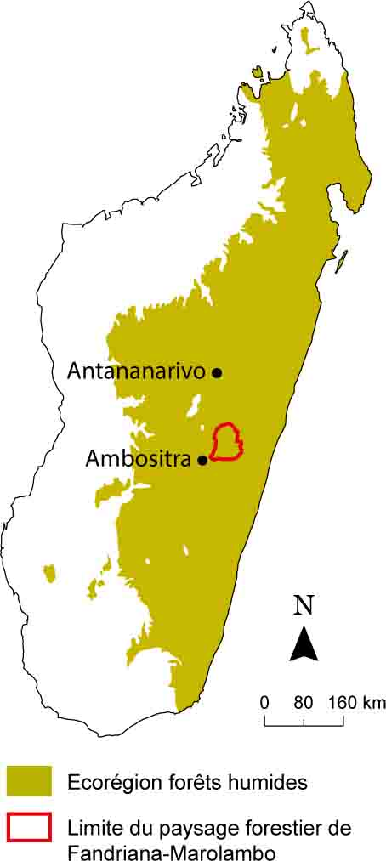
Fandriana-Marolambo Forest landscape
203,080 ha forest landscape
150,000 people living in the landscape
2,730 households live directly from the use of forest and natural resources
14 Communes,
3% population growing rate
Deforestation rates (1999 – 2000): 2.58%
Forest severely fragmented
Forested areas cleared and burnt for rice and sugarcane plantation
Migration into the forest to cultivate sugarcane
Clearing forest means of “land acquisition”

Slide 3
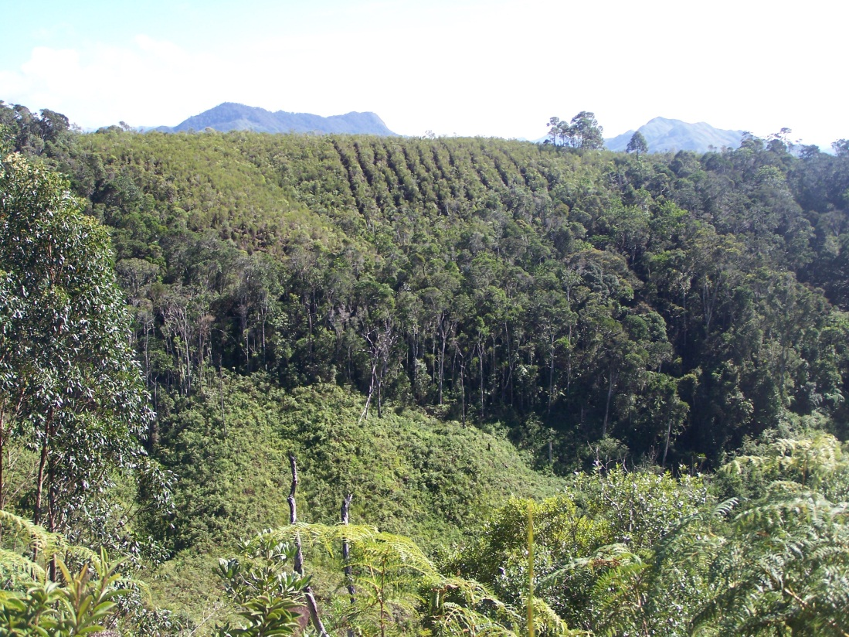
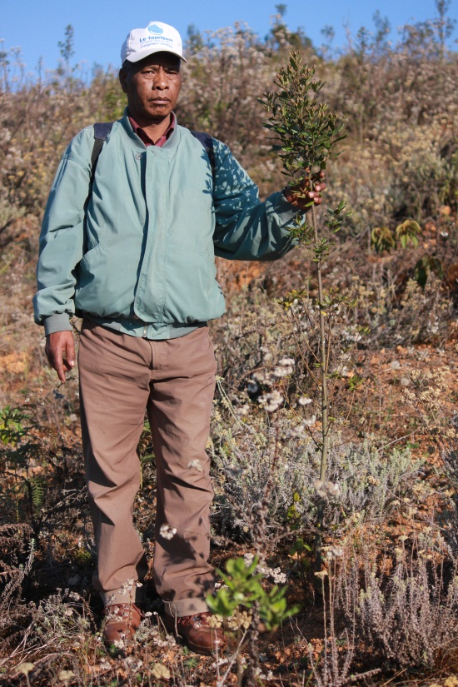
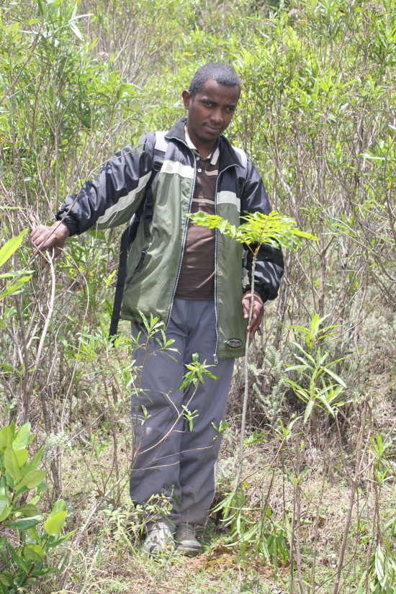
Results
Active and passive restoration: 6,786 ha
Community forest management : 51,743 ha
Protected area : 95,063 ha

Slide 4
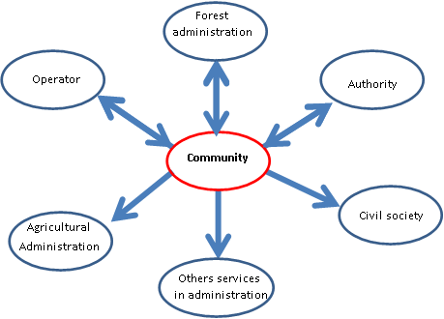
Lessons learnt: Governance, Partner and Main actors
Local governance structure needs to be strengthened
  From top-down, i.e. the forest service at the center, the process needs to be more bottom-up with the community at the center of the negotiation and decision-making.
  At the level of each village, each initiative /proposal was discussed with the community who integrated its interest, criticized and validated it
Establish multi-level partnerships
Initiation of the program : WWF
National working group, landscape working group
Local Government, Forest administration, Mayors, communities, private sector, other organizations such as Madagascar National Parks, Durrell Wildlife Conservation Trust

Slide 5
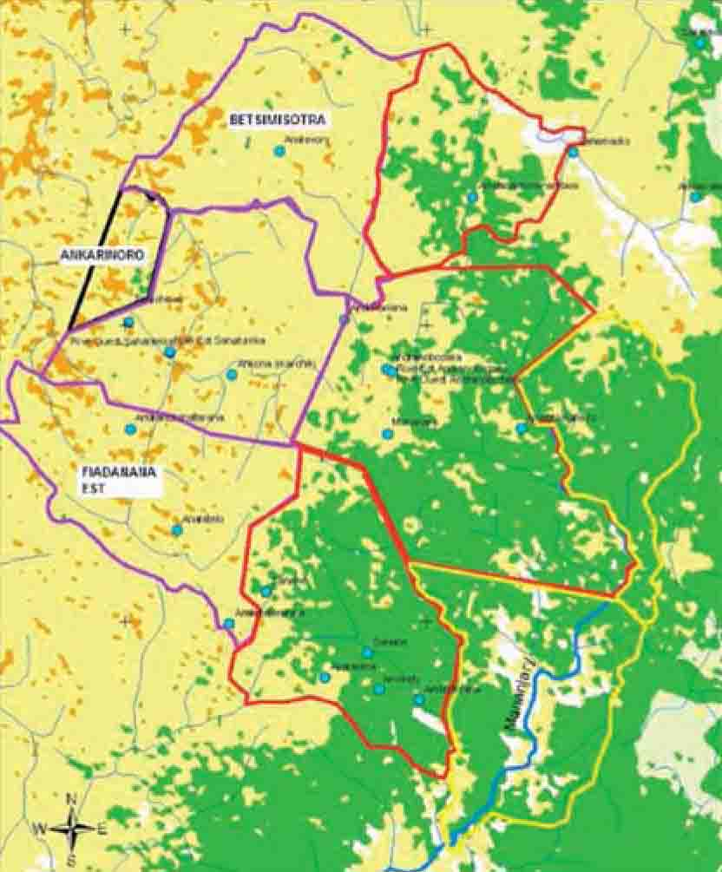
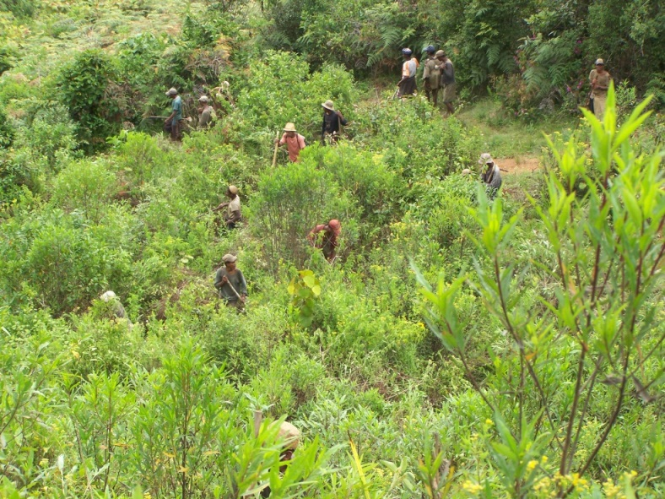
Lessons learnt : Social dimension, understanding of the ecological and socio-economic contexts
Success requires a strong social dimension
  Recognition by the administration of “tenure rights and social conventions informally constructed and based on lineages” and “traditional land tenure”
  Recognition of the traditional social structure and local leadership
  Support /build local structures/associations
Ground implementation needs scientific and traditional knowledge
  Several scientific studies and surveys (socio-economic and ecological) conducted / Important to better design and implement FLR interventions that are suited to local conditions
  From very simple elements (e.g. native tree species propagation techniques) to more complex issues (e.g. drivers of governance failures in the landscape
Notes:
Traditional knowledge: "varongy" or Ocotea cymosa, which is very important for house construction
Fallow system is done to restore soil fertility but burning before cultivation contributes to degrade them
Soil fertility begins to recover only after five years of fallow system
Long-term degradation from burning is manifested by the invasion of herbaceous species due to the disappearance of forest species and the degradation of soil conditions.

Slide 6
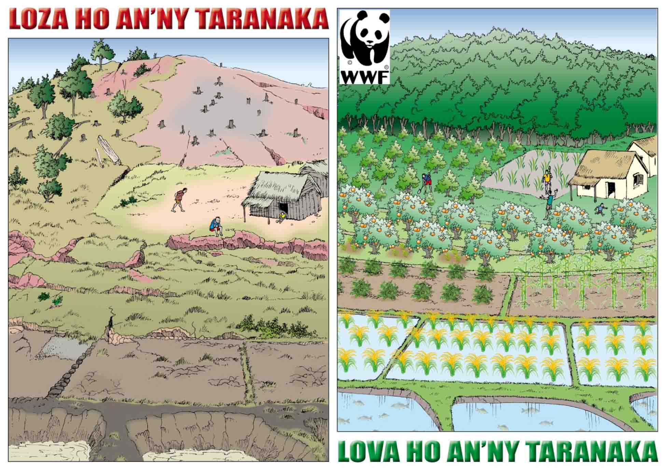
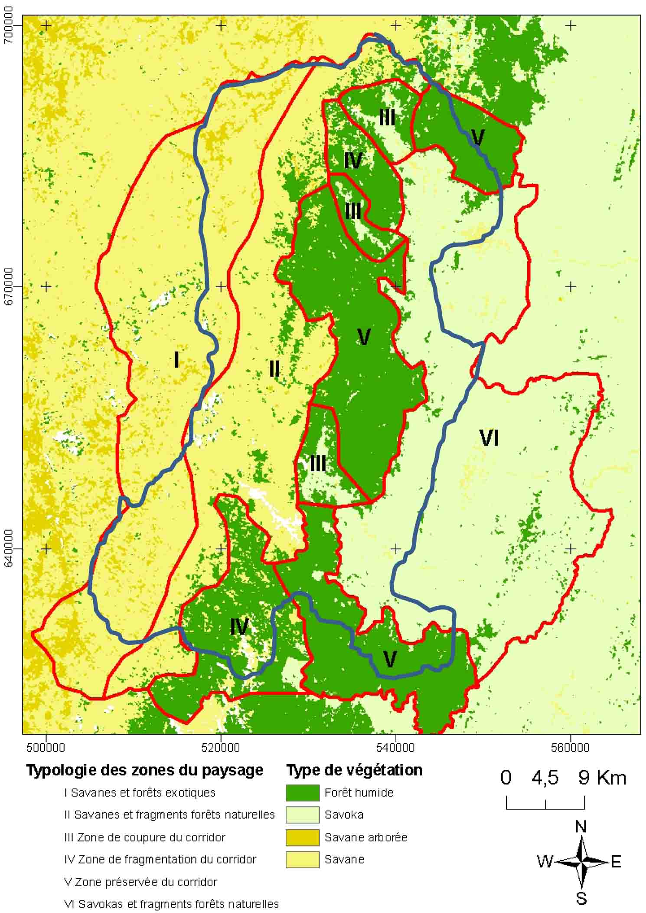
Lessons learnt : Process
Agreeing on a joint vision and zoning
Compromise through understanding the vision/priorities of each actor
Zoning: helps designing some restoration activities such as nursery development (II, III, IV, VI), adapting agriculture practices, identifying alternative income-generating options for local farmers (I, II, IV, VI)

Slide 7
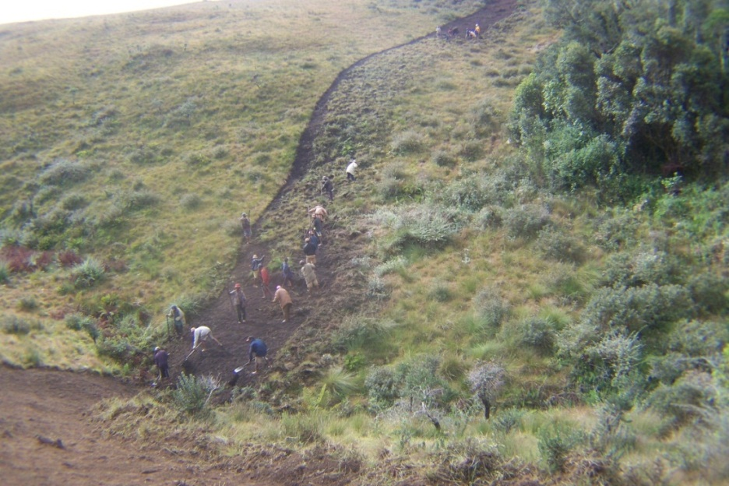
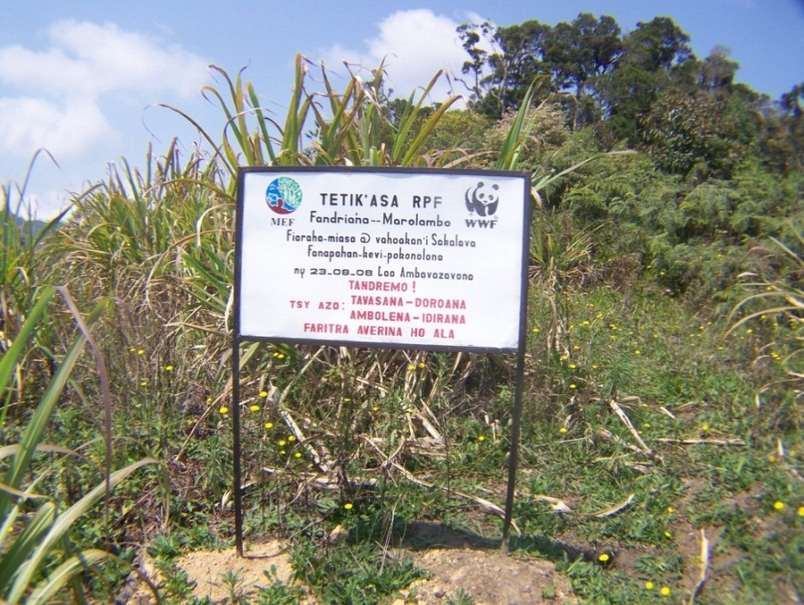
Lessons learnt : FLR Implementation
Scale really matters
  Many interventions may need to be local but they should integrate within a landscape-scale plan
  These local efforts aggregate to a larger “restored landscape”
Commit to the long term, maintain flexibility and design a sustainable process
  The landscape cannot be considered to be “restored” even after 13 years, many ingredients are in place for the longer term success
  Restoration work is iterative, building on different phases. Each phase has to be adjusted depending on the reality on the ground and the contexts
  Support local organizations networks that will continue beyond the project

Slide 8
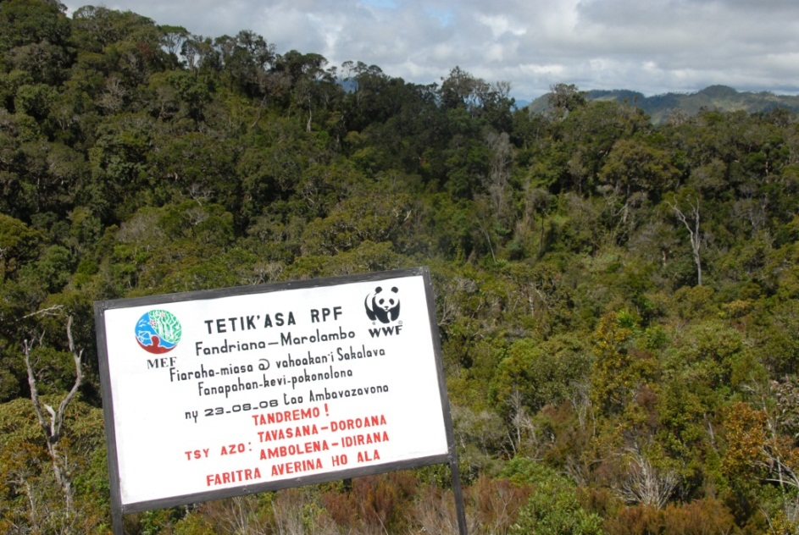
Lessons learnt : Monitoring, Protection, Capacity building
Monitoring is critical
  Monitoring needs to be integrated since the project initiation phase, must be secured in the long term
  Monitoring might be limited to punctual site-based actions, rather than measuring landscape-scale impact.
Restoration enhances protection
  Restoration can add value to areas protected through the tree plantation and so those areas becomes more respected by communities and improve the land tenure system

Slide 9
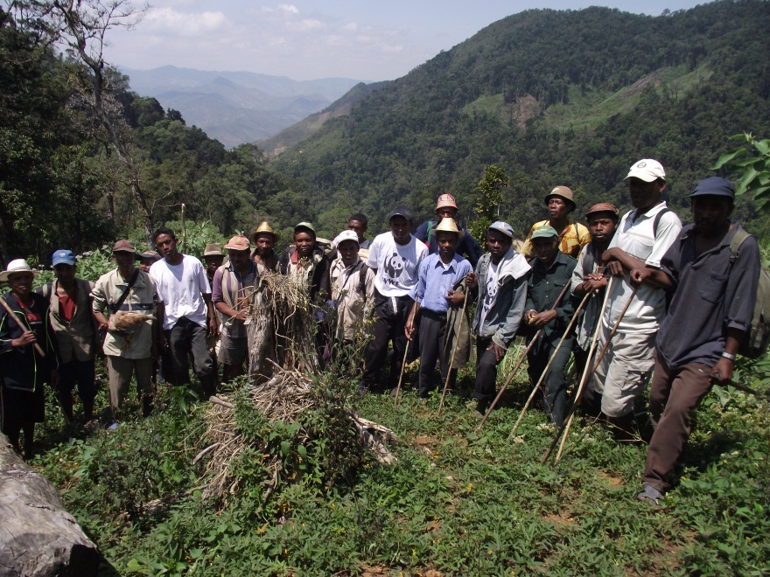
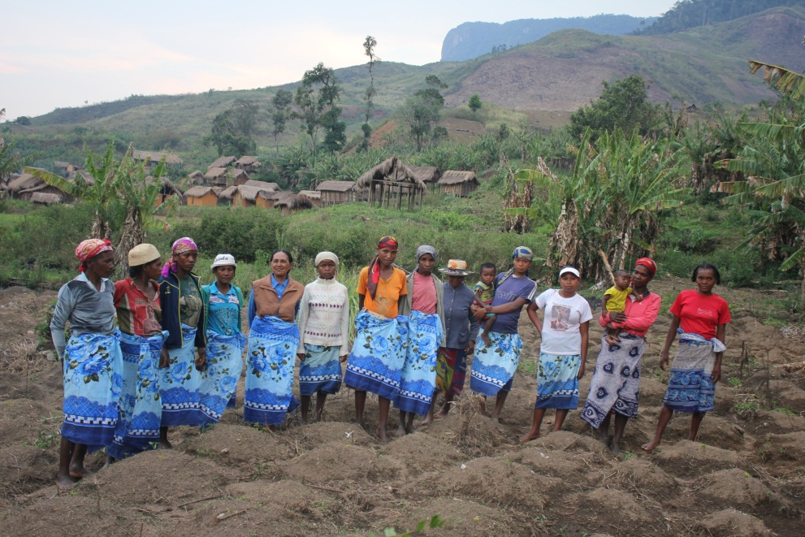
Summary and highlights
It is very important to design and implement forest landscape restoration with strong social dimension and strengthened local governance structure
  Bottom-up process with the community at the center of the negotiation /decision
  Multi-level partnerships
  Joint vision and zoning
  Strong social dimension
  Ground implementation using scientific and traditional knowledge
  Scale / site and landscape
  Long term, flexibility and sustainable process

Slide 10
  THANK YOU

